Slide 1
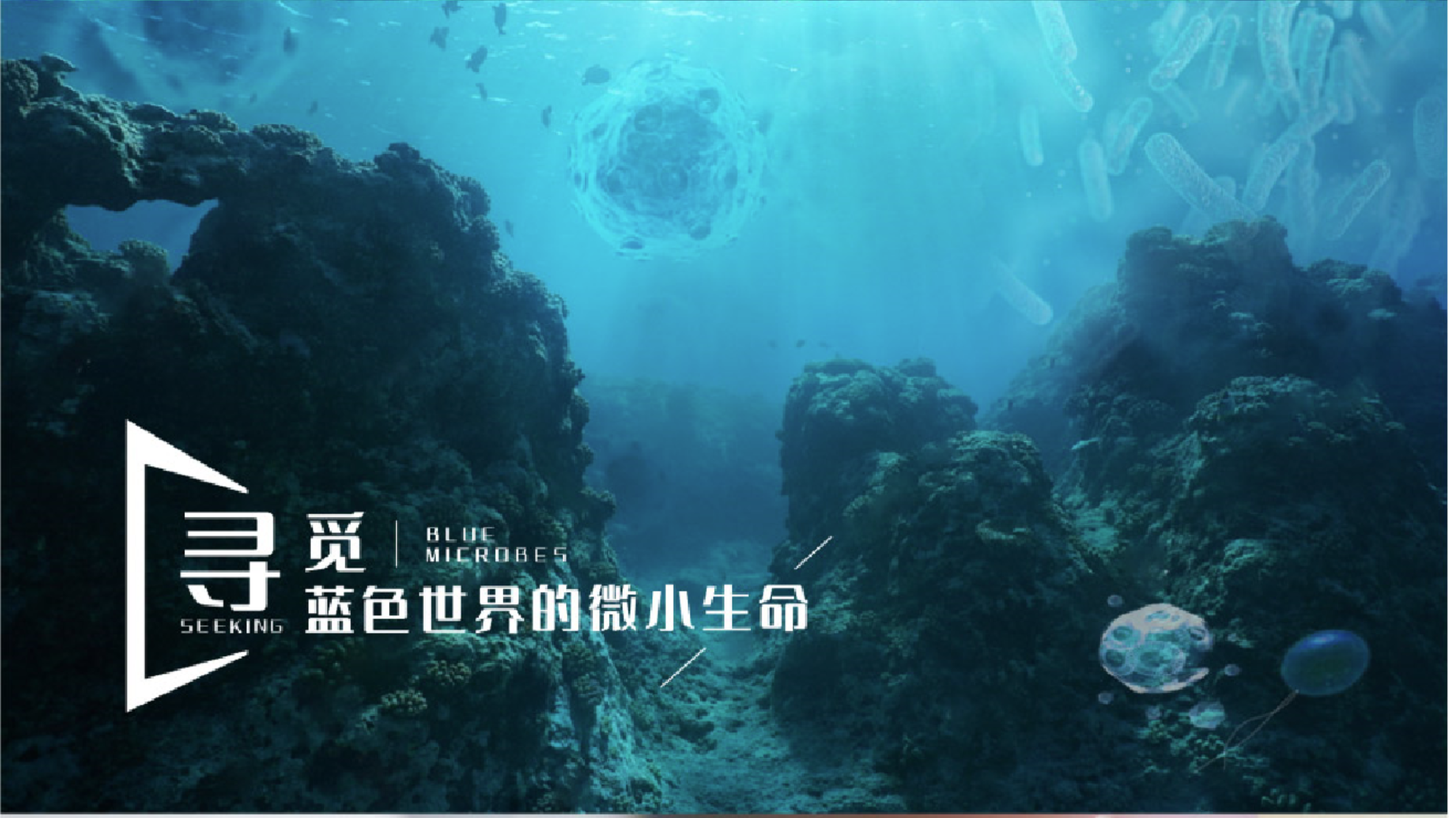
海洋微生物学及实验
2024-2025学年 冬第二周

Slide 2
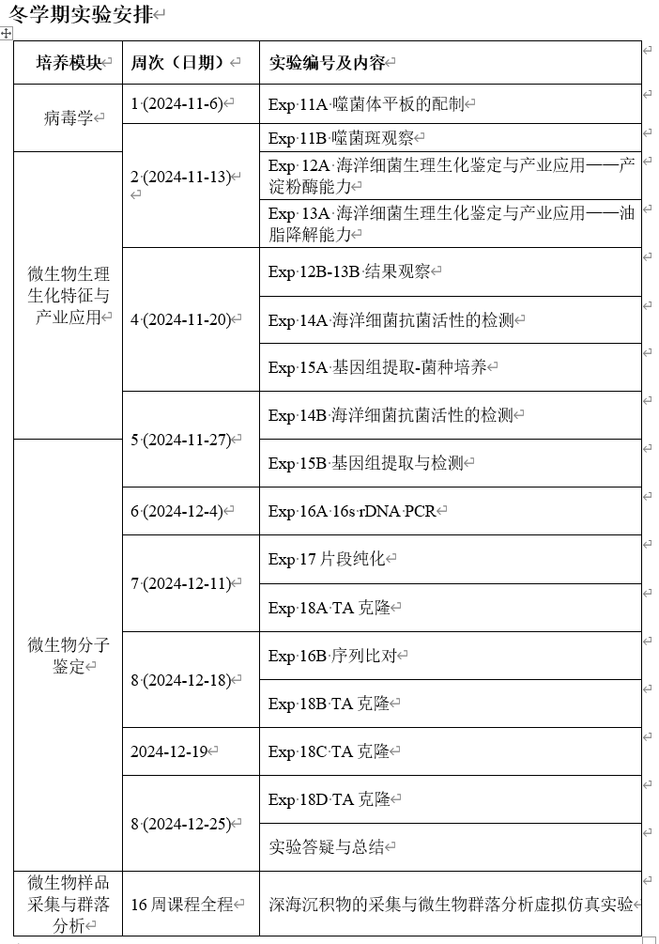

Slide 3
上周实验：
EXPERIMENT 11: PLAQUE ASSAY OF BACTERIOPHAGES
Exp 11A 噬菌体平板的配制
噬菌体的噬菌斑测定
Viruses are commonly characterized according to the type of cell they infect.
Animal viruses; plant viruses; bacterial viruses
What is the host of phage T4?
Bacteriophages are among the most common and diverse entities in the biosphere.
Plaques (噬菌斑) are produced because the virus does not infect all of the host cells. Uninfected cells grow and form a lawn covering the plate. Infected cells lyse, release phages which infect nearby cells to form a clear area in the lawn.
The drop-on-plate plaque assay is used to determine the titer (效价) of a phage stock, which is given as plaque forming units/mL (pfu/mL).
pfu/mL = the number of phages in the stock ?

Slide 4

上周实验：
Step 2. Making double-layer NA plate for plaque assay.
2 mL E. coli B culture (Ec)
Mix evenly by inverting ( Do not vortex)
50 mL pre-melted overlay agar
Solid NA plate (NA)
Pour about 3 mL overlay agar for each NA plate quickly, as agar will start to solidify at room temperature.
If overlay has lumps or uneven surface, repeat on new NA plate.
Allow to set for 2-3 min in sterile hood with air flow.
Double-layer NA plate

Slide 5

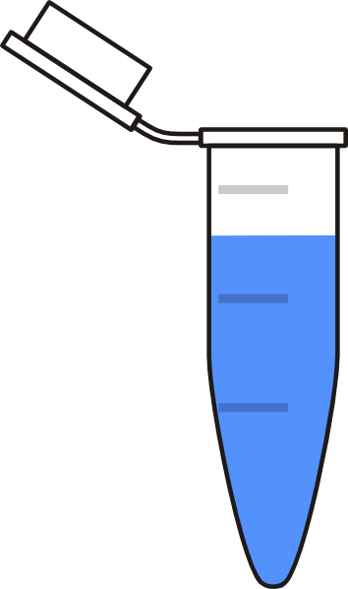
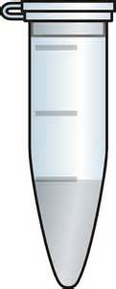
上周实验：
Step 3 : Serial dilution of T4 using Buffer. Pipetting up and down to mix completely.
Step 4: Add 10 μL drops of phage onto labelled double-layer plate (duplicate for each dilution).
Set at the plates in the hood for 5 min without air flow and moving.
5-fold
5-fold
Phage stock
(T4)
10 μL drop
5-fold
25-fold
Each dilution should be more than 30 μL
** Teaching assistant will transfer your plates to incubate at 37 °C. After 4-5 hours, the plaques appear.

Slide 6
本周：
EXPERIMENT 11: PLAQUE ASSAY OF BACTERIOPHAGES
EXP 11B
METHODS
Count the plaques on the plates those have countable numbers. If there are too many plaques, the entire drop area will be clear (record as “clear”).
Determine the titre of the phage stock per mL, as plaque forming units/mL (pfu/mL).

Slide 7
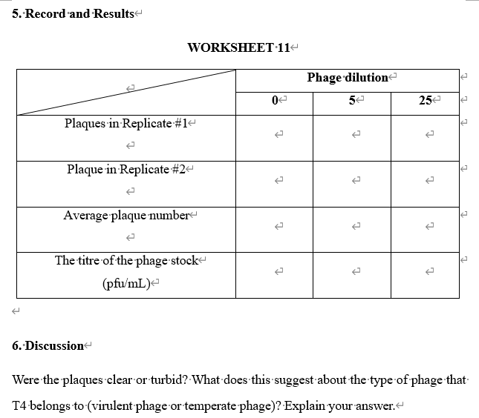
***下周三前 (11月20日12 点前) 提交EXP 8,9,11 的实验报告，钉钉提交，收到后均会回复！

Slide 8
EXPERIMENT 12: Alpha-amylase, an industrial enzyme produced by marine bacteria
Expt. 12A
1 × TSA (labeled “TSA”)
1 × TSA plus 0.2% starch plate (labeled “TSA/0.2%S”)
Three overnight (O/N) strains cultures in 1.5 mL tubes:
Escherichia coli, labeled “Ec”
Bacillus subtilis, labeled “Bs”
Bacillus amyloliquefaciens (isolated from seawater), labeled “Ba”
Your culture of isolated strain, labeled “Y”.
10 μL pipette and tips

Slide 9
Expt. 12A
1. In a sterile hood, label your TSA/0.2% starch plate on the base (agar side) around the edge in small letters, with your group number and date.
2. Divide the base of the plate into 4 sections and label the sections Ec, Bs, Ba, and Y as indicated in Fig. a.
3. Add a 5 μL drop of E. coli on to the representative plate section, as shown in Fig. b.
Place strains B. subtilis, B. amyloliquefaciens and your culture using fresh tips as in step 3.
a) b)
TSA/0.2%S
TSA/0.2%S
G1 15/11
G1 15/11
E
E
Y
Y
Ba
Ba
Bc
Bc
Single 5 μL drop

Slide 10
4. Repeat to drop the four strain cultures on TSA plate.
5. Allow the drops to soak into the agar for at least 15 minutes. Parafilm the plates and invert plates so base is on top, and then incubate for 24 h at 30-37 °C.

Slide 11
EXPERIMENT 13: Marine microbes in pollution control
Expt. 13A
Materials
1 × LB agar plate (labeled “LB”)
1 × LB plus Oil plate (labeled “OIL”)
1 × LB plus Neutral Red plate (labeled “NB”)
1 × LB plus Oil and Neutral Red plate (labeled “OIL/NB”)
Fresh liquid culture of Pseudomonas aeruginosa in 1.5 mL tube
(labeled “Pa ”)
Fresh liquid culture of Staphylococcus epidermidis in 1.5 mL tube
(labeled “Se”)
Fresh liquid culture of E. coli in 1.5 mL tube (labeled “Ec”)
Fresh liquid culture of your strain in liquid culture (labeled “Y ”)

Slide 12
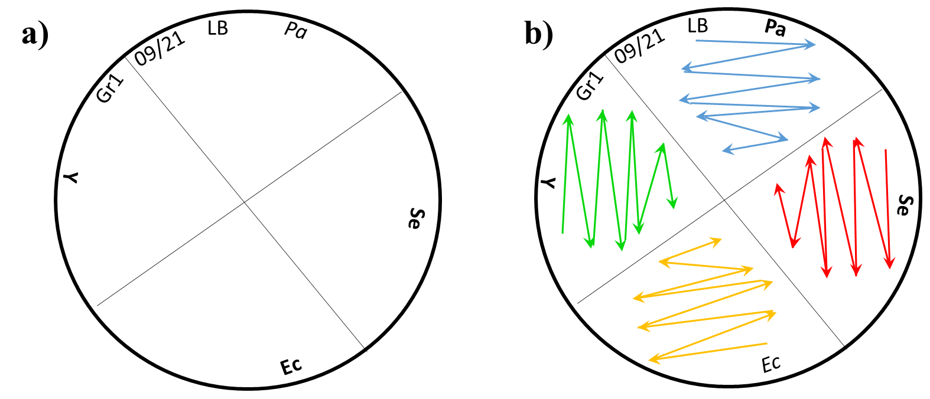
EXPERIMENT 13: Marine microbes in pollution control
Expt. 13A
METHODS
1. Label the base of plates as shown in Fig. a, and streak each strain onto LB agar plate as shown in Fig. b.
2. Repeat to streak the four strain cultures on the “OIL”, “NB” and “OIL/NB” plate, respectively.
3. Allow the drops to soak into the agar for at least 15 minutes. Parafilm the plates and invert plates so base is on top, and then incubate plates at 30-37 °C for 3-5 days.

